Slide 1

Lists and Iterators
Presentation for use with the textbook Data Structures and Algorithms in Java, 6th edition, by M. T. Goodrich, R. Tamassia, and M. H. Goldwasser, Wiley, 2014

Slide 2
Array Lists
7.2

Slide 3
Array Lists
An obvious choice for implementing the list ADT is to use an array, A, where A[i] stores (a reference to) the element with index i.
For now, assume that the array has a fixed capacity.
(The ArrayList type is vector in C++)
A
0
1
2
i
n

Slide 4
Array Lists
With a representation based on an array A, the get(i) and set(i, e) methods are easy to implement by accessing A[i] (assuming i is a legitimate index).
A
0
1
2
i
n

Slide 5
Insertion
In an operation add(i, o), we need to make room for the new element by shifting forward the n − i elements A[i], …, A[n − 1]
In the worst case (i = 0), this takes O(n) time
A
0
1
2
i
n
add(i,o)
A
0
1
2
i
n
A
o
0
1
2
i
n

Slide 6
Element Removal
In an operation remove(i), we need to fill the hole left by the removed element by shifting backward the n − i − 1 elements A[i + 1], …, A[n − 1]
In the worst case (i = 0), this takes O(n) time
A
o
remove(i)
0
1
2
i
n
A
0
1
2
i
n
A
0
1
2
i
n

Slide 7
ArrayList

Slide 8
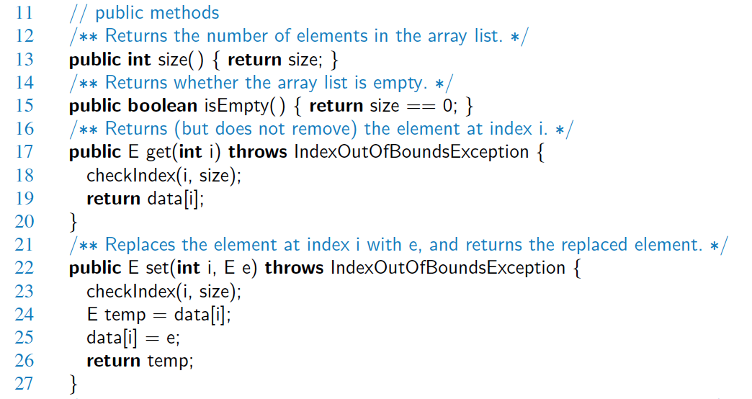
Java Implementation

Slide 9
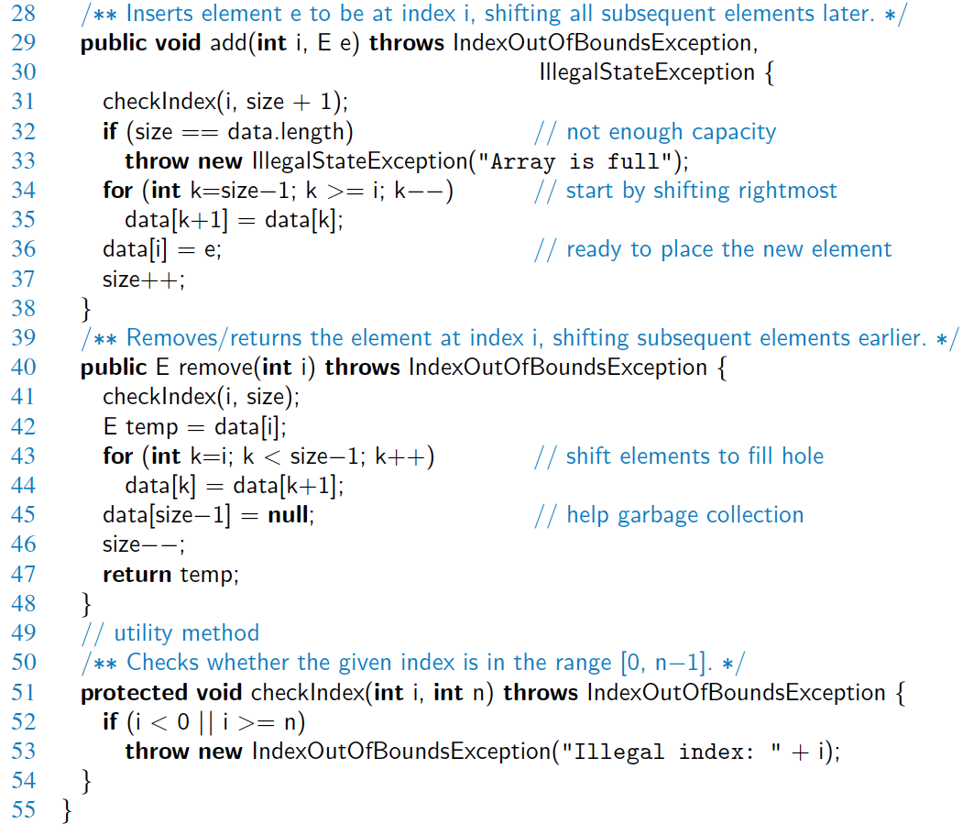
Java Implementation, 2

Slide 10
Performance, big-oh functions
Performance of an array list with n elements realized by a fixed-capacity array
Method | Running Time
size() | O(1)
isEmpty() | O(1)
get(i) | O(1)
set(i, e) | O(1)
add(i, e) | O(n)
remove(i) | O(n)

Slide 11
Performance
In an array-based implementation of a dynamic list:
The space used by the data structure is O(n)
Indexing the element at i takes O(1) time
add and remove run in O(n) time
In an add operation, when the array is full, instead of throwing an exception, we can replace the array with a larger one …

Slide 12
Reinforcement
R-7.2, p. 300. Give an implementation of the stack ADT using an array list for storage.
List operators
E get(i)
E set (i, E e)
void add (i, E e)
E remove(i)
Stack operators
void push(E e)
E pop()
E peek()

Slide 13
Dynamic Arrays
7.2.1

Slide 14
ArrayList
The Array List abstract type appears to offer unlimited capacity
A chief advantage of the Array List over arrays:
In the implementation, you can avoid rejecting new entries when full
You can grow the underlying array
Hidden from any code that uses the ArrayList class

Slide 15
ArrayList using Dynamic Arrays
The Array List abstract type appears to offer unlimited capacity
How

Slide 16
Dynamic Arrays
Dynamic arrays are stored in regular arrays
Arrays are stored in consecutive memory elements in computer memory:
Normally, you can't expand the capacity
You want a dynamic array

Slide 17
Implementing a Dynamic Array
7.2.2

Slide 18
Implementing Dynamic Arrays
Create a dynamic array
When adding an element threatens to overflow the array, grow it by these steps:
Allocate a new array B with larger capacity.
Set B[k] = A[k], for k = 0,..., n − 1, where n denotes current number of items.
Set A = B, that is, we henceforth use the new array to support the list.
Insert the new element in the new array.

Slide 19
Implementing Dynamic Arrays
create a new array B;
store the elements of A in B;
Set A = B, that is, we henceforth use the new array to support the list.

Slide 20
Implementing Dynamic Arrays
create a new array B;
store the elements of A in B;
Set A = B, that is, we henceforth use the new array to support the list.

Slide 21
Implementing Dynamic Arrays
Change the implementation of add(i,e) to include resizing

Slide 22
Implementing Dynamic Arrays
Resize method creates a new array and copies the data from the old one

Slide 23
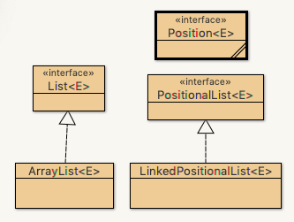
Java ArrayList Implementation
Open up DSAJ-sourcecode with BlueJ
find package net.datastructures
open
file ArrayList.java

